Slide 1


ISE 519 PROJECT
NCSU EMAS DATABASE MANAGEMENT SYSTEM
Niket Mistry
Shyam Engineer
Sreekanth Katabathula
EMAS POC: Dr. Trey Standish

Slide 2
What is EMAS?
Provide critical services to students throughout their student life from recruitment, enrollment and retention through graduation and beyond.
Data Analysis and Research within EMAS provides data research and IT solutions to streamline business functions to support university initiatives related to student success, diversity, globalization, brand awareness and overall institutional effectiveness.
One of the objectives of the department is to collect and analyse data of student applicants to help the university develop better marketing strategies.

Slide 3
Problem Description
A lot of data containing student information in a few excel files is very hard to interpret and get useful information for a particular student.
Calculation of probability of a student coming to NC State from the data in a single row containing large number of columns is a tedious work to do.
It is not very convenient to come up with good decisions when you have to collect data from different files and do all the necessary calculations manually.
A lot of data which is useful in calculations but not required by the administrators often slows down the actual work needed to be done.
Notes:
Visuals?

Slide 4
Solution
A database application which retrieves data of student applicants and displays it in an organized manner.
A probability model inside the application calculates the likelihood of a student coming to NC State.
A GUI made from an administrator’s point of view makes it easy to retrieve and interpret student information.
Interactive chart gives the administrators insight into the enrolment statistics of a student which is useful to make informed decisions.
One tool which does all the operations required by the department and increase efficiency of work.

Slide 5
Initial Process Flow
Step 1
Step 2
Step 3
CSV database
160 Columns
Instate
Out of State
Data Cleaning
Removing unusual data
Build Probability Model
Instate Cleaned
Out of State Cleaned
Temporary Table
Only 19 necessary columns for students

Slide 6
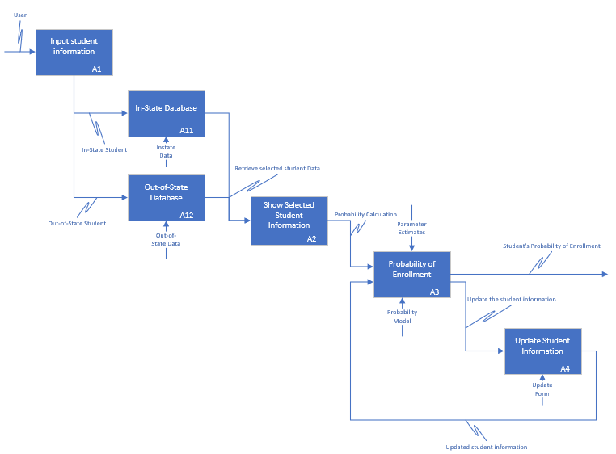

Slide 7
How does this help?
Easy student data retrieval system
Time saving in student enrolment probability estimation
Flexibility in updating student information
Helps the people on ground (real-time probability calculation)
This application is a powerful tool for the university to determine marketing/business strategies for enrollment of potential students and facilitates rapid decision making.

Slide 8
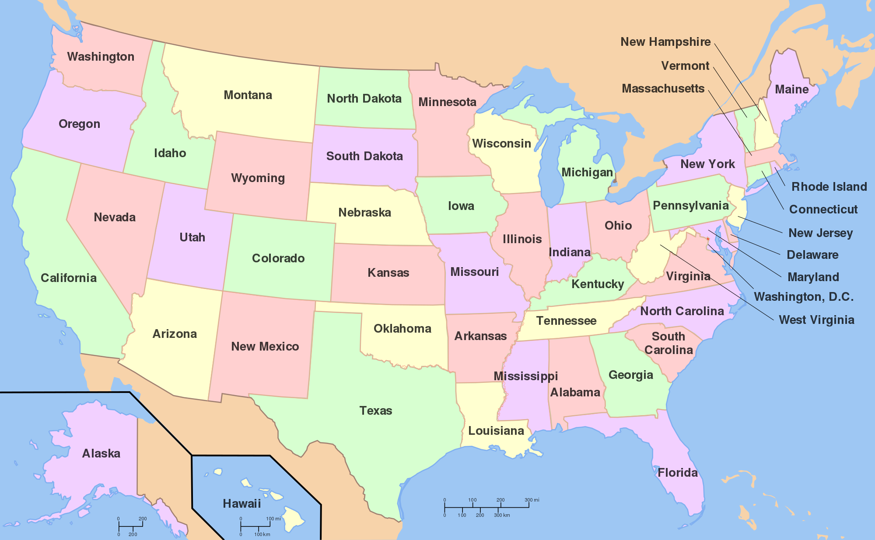
Future Scope
Include students with incomplete information.
Improved probability estimation model
Better Marketing strategies using the new model
Integrating it with other softwares

Slide 9

Thank you!
Any Questions?
Have a great Thanksgiving!

